Slide 1
Overview of Multi-Core Technology
Unit – 1
By
Raju K
CSE Dept

Slide 2
Single-core computer

Slide 3
Single-core CPU chip
the single core

Slide 4
What is serial computing
Traditionally, software has been written for serial computation:
To be run on a single computer having a single Central Processing Unit (CPU);
A problem is broken into a discrete series of instructions.
Instructions are executed one after another.
Only one instruction may execute at any moment in time.

Slide 5
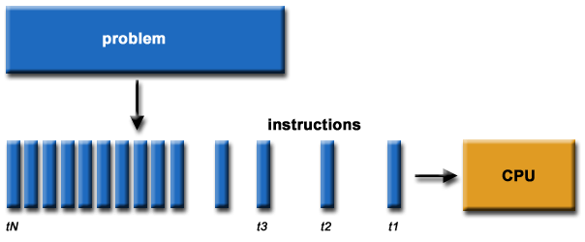
Serial computing

Slide 6
Limits
Transmission speeds
Limits to miniaturization
Economic limitations
Power consumption & heat generation

Slide 7
Limits
Limits to serial computing: Both physical and practical reasons pose significant constraints to simply building ever faster serial computers:
Transmission speeds - the speed of a serial computer is directly dependent upon how fast data can move through hardware. Absolute limits are the speed of light (30 cm/nanosecond) and the transmission limit of copper wire (9 cm/nanosecond). Increasing speeds necessitate increasing proximity of processing elements.
Limits to miniaturization - processor technology is allowing an increasing number of transistors to be placed on a chip. However, even with molecular or atomic-level components, a limit will be reached on how small components can be.
Economic limitations - it is increasingly expensive to make a single processor faster. Using a larger number of moderately fast commodity processors to achieve the same (or better) performance is less expensive.

Slide 8
Limits…
Relation btwn frequency of operation and power consumption is given by :
Power= ½ x Capacitive load x Voltage² x Frequency
Power consumption is a huge problem when frequency is increased
More is the power consumed, more will be the heat generated

Slide 9
The Current Solution
Multi-Cores

Slide 10
Multi-Cores
Multicore processors
New type of computer architecture
Dominates new processor market
Desktops, servers, mobile devices, etc.
Almost all chips will be multicore soon
Challenges
How to design software for these chips?
How to design the chips themselves?
How to structure hardware/software interaction?

Slide 11
Multi-core architectures
Replicate multiple processor cores of moderate speed on a single die.
Core 1
Core 2
Core 3
Core 4
Multi-core CPU chip

Slide 12
Multi-core CPU chip
The cores fit on a single processor socket
Also called CMP (Chip Multi-Processor)
core
1
core
2
core
3
core
4

Slide 13
The cores run in parallel
thread 1
thread 2
thread 3
thread 4
core
1
core
2
core
3
core
4

Slide 14
Within each core, threads are time-sliced (just like on a uniprocessor)
several threads
several threads
several threads
several threads
core
1
core
2
core
3
core
4

Slide 15
Why multi-core ?
Difficult to make single-core clock frequencies even higher
Deeply pipelined circuits:
heat problems
speed of light problems
difficult design and verification
large design teams necessary
server farms need expensive air-conditioning
Many new applications are multithreaded
General trend in computer architecture (shift towards more parallelism)

Slide 16
Conventional vs. Multicore slides by : Dr. Alexandra Fedorova School of Computing Science SFU
Core 0
Core 0
Core 1
L1 cache
L1 cache
L1 cache
L2 cache
L2 cache
Conventional processor
Single core
Dedicated caches
One thread at a time
Multicore processors
At least two cores
Shared caches
Many threads simultaneously

Slide 17
The Multicore Revolution
Most new processors are multicore
intel.com: Most processors shipped are multicore:
2006: 75% for desktops, 85% for servers
2007: 90% for desktop and mobile, 100% for servers
Everyone’s doing it
Intel Celeron Dual Core
Sun Microsystems Rock, Niagara 1, Niagara 2
IBM Power4, Power5, Power6, Cell
AMD Quad Core (Barcelona)
Embedded: ARM

Slide 18
Superior Performance/Watt
Example:
Reduce CPU clock frequency by 20%
Power consumption reduces by 50%!
0.5x power
0.5x power
Put two 0.8 frequency cores on the same chip
Get 1.6 times the computation at the same power consumption
0.8x frequency
0.8x frequency
Core 0
Core 1
L1 cache
L1 cache
L2 cache

Slide 19
Why Multicore?
Increasing processor clock speed (GHz) is inefficient
Increase clock speed by 20%
Power increases by ≈75%
How much does performance increase?

Slide 20
Multicore vs. Unicore
Multicore:
1.6x throughput increase
No power consumption increase
Single-core:
1.2x throughput increase
1.75x power increase

Slide 21
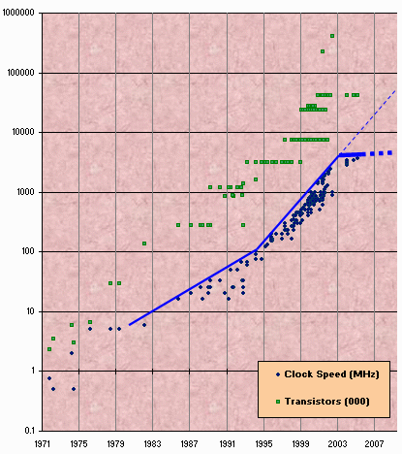
Transistor density vs Clock speed
Transistor density still rising
Clock speed isn’t
Transistors are used for parallelism: multicore processors

Slide 22
Multicore Potential
Multicores offer potential to compute more efficiently
Applications and systems are not ready to realize that potential
What needs to be done?
A fundamental shift to parallel programming
New ways to manage resources in the operating system

Slide 23
Multicore Examples
IBM Power4
first dual core; 2001
Intel Celeron Dual Core
first consumer dual core; 2004
AMD Athlon, IBM Xenon, Intel Xeon
80- and 100-core machines coming soon
1000+ core chips in development

Slide 24
What’s Important to Remember?
Massive parallelism
Good or bad?
Good: We can use processor more efficiently
Bad: We don’t know how to make the most out of it.
Shared resources
Good or bad?
Good: More efficient resource utilization (the reason for multicore)
Bad: Contention for resources

Slide 25
So, what is Parallel Computing ?
Parallel Computing is the simultaneous use of multiple compute resources to solve a computational problem:
To be run using multiple CPUs
A problem is broken into discrete parts that can be solved concurrently
Each part is further broken down to a series of instructions
Instructions from each part execute simultaneously on different CPUs
Hence, Multi-Core processing is a type of parallel computing

Slide 26
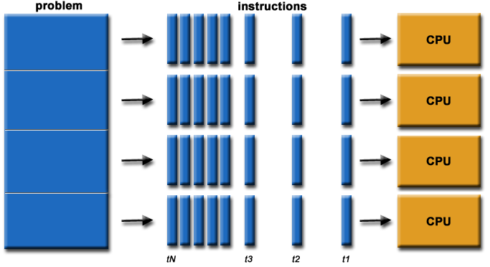
Parallel computing

Slide 27
What are the types of
Parallel Computing ?
Thread-level parallelism (TLP)
Process level parallelism : Multiprocessors
Instruction-level parallelism : Pipelining

Slide 28
Process-Level Parallelism (Multitasking)
Early computers (1950s and 1960s) could only run one program at a time
When it finished, then it would run the next one ( aka single tasking )
Multi-programming operating systems (1970s) made it appear as if multiple programs were running at the same time by switching between them (aka multitasking)
Notes:
ng

Slide 29
Thread-Level Parallelism
Modern programming languages support “threads”, so that one program can do multiple things
Example: handling user input while performing a calculation
Do the threads in a multi-threaded program really run simultaneously?

Slide 30
Thread Level Parallelism
A thread is defined as a separate process with its own instructions and data – ie an independent pgm.
This is the traditional (OS) definition
shares instructions with other threads but they each have their own stack and data
a thread in this case is multiple versions of the same process
Or a thread may be single program executing in parallel – ie, a pgm with multiple processes
Here, the each thread offers different instructions and data
the processor, when it has to stall, can switch to another thread and continue execution
does not cause time consuming stalls
Each thread has all the state (instructions, data, PC, register state, and so on) necessary to allow it to execute
Data Level Parallelism: Perform identical operations on data, and lots of data

Slide 31
Thread Level Parallelism (TLP)
ILP exploits implicit parallel operations within a loop or straight-line code segment
TLP explicitly represented by the use of multiple threads of execution that are inherently parallel
Goal: Use multiple instruction streams to improve
Throughput of computers that run many programs
Execution time of multi-threaded programs
TLP could be more cost-effective to exploit than ILP

Slide 32
Mulithreaded Execution
Multithreading: multiple threads to share the functional units of 1 processor via overlapping
processor must duplicate independent state of each thread e.g., a separate copy of register file, a separate PC, and for running independent programs, a separate page table
memory shared through the virtual memory mechanisms, which already support multiple processes
Thread switching
Alternate instruction per thread (fine grain)
When a thread is stalled, perhaps for a cache miss, another thread can be executed (coarse grain)

Slide 33
Instruction-level parallelism
Parallelism at the machine-instruction level
Rather than wait for an instruction to finish, start the next one as soon as possible
Very common in RISC architectures
The processor can re-order, pipeline instructions, do aggressive branch prediction, etc.
Instruction-level parallelism enabled rapid increases in processor speeds over the last 15 years

Slide 34
Steps in Executing Instructions
IFetch: Fetch Instruction, Increment PC
2) Decode Instruction, Read Registers
3) Execute: Mem-ref : Calculate Address Arith-log : Perform Operation
4) Memory access: Load : Read Data from Memory Store : Write Data to Memory
5) Write Back: Write Data to Register

Slide 35
A simple Datapath for MIPS
rd
PC
instruction
memory
registers
rs
Data
memory
rt
ALU
+4
imm
2. Decode/
Register Read
1. Instruction
Fetch
3. Execute
4. Memory
5. Write Back
Use datapath figure to represent pipeline
IFtch
Dcd
Exec
Mem
WB
I$
Reg
ALU
D$
Reg

Slide 36
Pipelining
Observations
the ALU is doing an addition (say), the decoder is sitting idle; can we use it for some other instruction?
In the second cycle I know if it is a branch; if not, start fetching the next instruction?
Branches complete in the third cycle; why not start fetching the next instruction now?
In summary, exactly one phase is active at any point in time: wastes hardware resources
Form a pipeline
Process five instructions in parallel
Each instruction is in a different stage of processing (called pipe stage)

Slide 37
Pipelining - Definition
Is an implementation technique whereby multiple instructions are overlapped in execution; it takes advantage of parallelism that exists among the actions needed to execute an instruction.
Today, pipelining is the key implementation
technique used to make fast CPUs.

Slide 38
Non pipelined
1 2 3 4 5 6 7 8 9 10
time
instruction

Slide 39
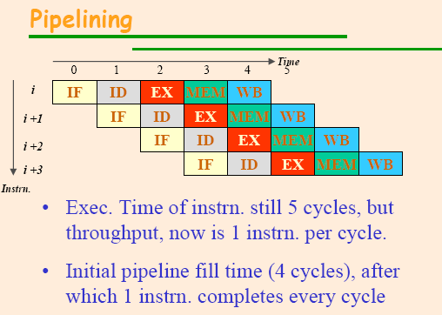

Slide 40
Pipelining: Its Natural!
Laundry Example
Ann, Brian, Cathy, Dave each have one load of clothes to wash, dry, and fold
Washer takes 30 minutes
Dryer takes 40 minutes
“Folder” takes 20 minutes
A
B
C
D

Slide 41
Sequential Laundry
6 PM
7
8
9
10
11
Midnight
Time
30
40
20
30
40
20
30
40
20
30
40
20
T
a
s
k
O
r
d
e
r
A
B
C
D
Sequential laundry takes 6 hours for 4 loads
If they learned pipelining, how long would laundry take?

Slide 42
Pipelined Laundry Start work ASAP
6 PM
7
8
9
10
11
Midnight
Time
30
40
40
40
40
20
T
a
s
k
O
r
d
e
r
A
B
C
D
Pipelined laundry takes 3.5 hours for 4 loads

Slide 43
General Definitions
Latency: time to completely execute a certain task
Throughput: amount of work that can be done over a period of time

Slide 44
Pipelined Design
Motivation: Increase throughput with
little increase in hardware
Latency required for each task remains the same or may even increase slightly.

Slide 45
Gain
Parallelism
Extracting parallelism from a sequential instruction stream: known as instruction-level parallelism (ILP)
Can complete one instruction every cycle (ideally)
Ideally, CPI is five times smaller
Overall execution time of the pgm goes down

Slide 46
Loss
Imbalance among pipe stages limits cycle time to slowest stage
Each instruction may take slightly longer
Resource conflicts
Bigger memory
Pipelining overhead
Pipeline register delay
Hazards
prevent next instruction from executing during its designated clock cycle

Slide 47
Hazards – 3 types
1.Structural hazard
if some combination of instructions try to access the same resource in a given cycle then resource conflict arises, and the processor will have Strucural Hazard
3.Control hazard
10: beq r1,r3,36
14: and r2,r3,r5
18: or r6,r1,r7
22: add r8,r1,r9
36: xor r10,r1,r11
If branch happens,
what do you do with the 3 instructions in between?
2.Data hazard
I: add r1,r2,r3
J: sub r4,r1,r3
Instruction j cant begin execution until instr i completes its execution as instr j is data dependent on instr i.

Slide 48
General context: Multiprocessors
“A parallel computer is a collection of processing elements that cooperate and communicate to solve large problems fast.”
Parallel Architecture = Computer Architecture + Communication Architecture

Slide 49
Flynn’s Classification : classification based on the notions of instruction and data streams
Classification of Multiprocessors
Architecture Categories
SISD
SIMD
MISD
MIMD

Slide 50
SISD single instruction stream over a single data stream
SISD machine executes a single instruction on individual data values using a single processor.
Based on traditional Von Neumann uniprocessor architecture, instructions are executed sequentially or serially, one step after the next.
Until most recently, most computers are of SISD type.
IS
C
IS
P
DS
M

Slide 51
Captions
C – control unit
P – processing unit
M – memory unit
IS – instruction stream
DS – data stream
PE – processing element ( all PE’s are synchronized by same control unit

Slide 52
SIMD Single Instruction, Multiple Data
PE1
DS
M
IS
C
PEn
DS

Slide 53
SIMD
An SIMD machine executes a single instruction on multiple data values simultaneously using many processors.
Since there is only one instruction, each processor does not have to fetch and decode each instruction. Instead, a single control unit does the fetch and decoding for all processors
SIMD architectures include array processors.

Slide 54
Multiple Instruction, Single Data (MISD)
This category does not actually exist. This category was included in the taxonomy for the sake of completeness.
IS
C
IS
P1
DS
M
IS
C
IS
Pn
DS

Slide 55
Multiple Instruction, Multiple Data
IS
C
IS
P1
DS
M
IS
C
IS
Pn
DS

Slide 56
MIMD
MIMD machines are usually referred to as multiprocessors or multicomputers.
It may execute multiple instructions simultaneously, contrary to SIMD machines.
Each processor must include its own control unit that will assign to the processors parts of a task or a separate task.
It has two subclasses: Shared memory and distributed memory

Slide 57
Multiprocessor memory types (Parallel memory architecture)
2 classes of multiprocessors WRT memory:
Centralized Memory Multiprocessor
< few dozen processor chips (and < 100 cores) in 2006
Small enough to share single, centralized memory
Physically Distributed-Memory multiprocessor
Larger number chips
Due to high bandwidth demands of centralized system, memory is distributed among processors

Slide 58
Centralized vs. Distributed Memory
Scale
P
P
P
1
n
P
n
1
$
$
$
$
Mem
Mem
Inter
connection network
Inter
connection network
Mem
Mem
Centralized Memory
Distributed Memory

Slide 59
Centralized Memory Multiprocessor
Also called symmetric multiprocessors (SMPs) because single main memory (and I/O) has a symmetric relationship to all processors
Large caches ⇒ single memory can satisfy memory demands of small number of processors
Can scale to a few dozen processors by using a switch and by using many memory banks
Although scaling beyond that is technically conceivable, it becomes less attractive as the number of processors sharing centralized memory increases

Slide 60
Distributed Memory Multiprocessor
Pros:
Cost-effective way to scale memory bandwidth, if most accesses are to local memory
Reduces latency of local memory accesses
Cons:
Communicating data between processors more complex
Must change software to take advantage of increased memory BW

Slide 61
2 Models for Communication and Memory Architecture
Message-passing multiprocessors: Communication occurs by explicitly passing messages among the processors:
Shared memory multiprocessors : Communication occurs through a shared address space (via loads and stores)
Two types -
UMA : Uniform Memory Access time for shared address, centralized memory MP
NUMA : Non Uniform Memory Access time for shared address, distributed memory MP

Slide 62
SMP Implementation
Shared-Memory multiprocessor model
Processors to Memory AND to I/O are symmetric
Bus based: all memory locations equal access time so SMP = “Symmetric MP”
Sharing limited bus BW as adding processors, I/O
Very popular, basis of small-scale commercial MP systems
Now the SMP model has moved into a single chip, Chip Multiprocessor (CMP)

Slide 63
Centralized Shared-Memory Multiprocessors

Slide 64
Distributed-Memory Multiprocessors

Slide 65
Multi-core processor is a special kind of a multiprocessor: All processors are on the same chip
Multi-core processors are MIMD: Different cores execute different threads (Multiple Instructions), operating on different parts of memory (Multiple Data).
Multi-core is a shared memory multiprocessor: All cores share the same memory – Centralized shared memory

Slide 66
CMPs
Single chip multi processors or CMPS : another name for Multi Core Architecture
Multiple smaller energy efficient processing cores are integrated onto a single chip
Improves overall performance by performing more work parallelly
The latencies associated with chip-to-chip communication disappear, Shared data structures are much less of a problem.
Case for CMPs
Advances in the field of integrated chip processing.
Gate density (More transistors per chip)
Cost of wires

Slide 67
CMP Architectures
Two general types of multi-core or chip multiprocessor (CMP) architectures
Homogeneous CMPs – all processing elements (PEs) are the same
Heterogeneous CMPs – comprised of different PEs
Homogenous dual-core processors for PCs are now available from all major manufactures
Heterogeneous CMPs are available in the form of multiprocessor systems-on-chips (MPSoCs)

Slide 68
Hyper Threading

Slide 69
Superscalar Processors
Issues multiple instructions in each cycle. Typically 4.
Several functional units of the same type, e.g. ALUs
Dispatcher reads instructions, decides which can run in parallel
Limited by instruction dependencies and long-latency operations
Effects Horizontal & Vertical Waste
Low Utilization even with higher-issue machines; 8 Issue with %20

Slide 71
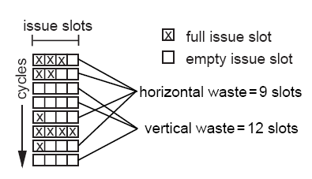
Vertical Slot & Horizontal Slot
Vertical waste is introduced when the processor issues no instructions in a cycle
Horizontal waste is introduced when not all issue slots can be filled in a cycle.
%61 of the wasted cycles are vertical waste.
Notes:
Slots are used to understand the evolution to the SMT.

Slide 72
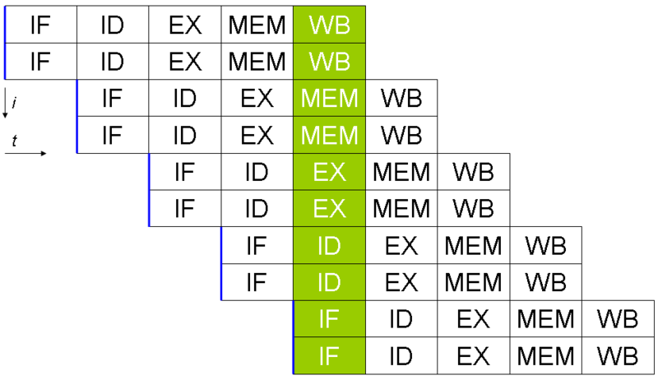
Superscalar Processors- 2 issue

Slide 73
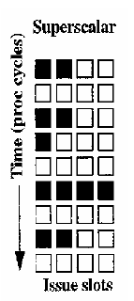
Superscalar Processors
• Does well when there is lots of ILP, but ILP in general applications is limited due to dependencies
•Cannot exploit TLP effectively since only one context can be served at any one time.

Slide 74
Simultaneous Multi Threading : Idea
Combine Superscalar and Multithreading such that;
Issue multiple instructions per cycle – Supercalar
Hardware state for several programs/threads – Multithreading
So; issue multiple instructions from multiple threads in each cycle

Slide 75
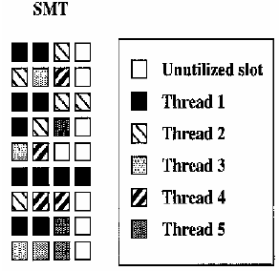
Simultaneous Multi Threading
Best of both worlds – run multiple threads simultaneously on a unified processor so that resource utilization is maximized
• Good for applications with either good ILP or TLP

Slide 76
Implementation
Processor is presented to OS as n logical processors, hardware provides support for n independent contexts
Context-supporting resources are either replicated n times or shared
Replicated Processor Resources
Program counters
Subroutine return stacks
I-cache ports
Instruction TLB
Architectural registers
Shared Processor Resources
Functional units
Caches
Physical registers

Slide 77
Benefits
Higher resource utilization => more speedup
Good performance over wider range of applications
Unified cache => No cache coherency overhead

Slide 78
Tradeoffs
Register file is the limiting factor in SMT machines
Larger register file – higher cost and slower access time.(May increase the cycle time)
Memory bandwidth requirement is more
Contention- threads tend to have the same resource needs at the same time

Slide 79
Hyper-Threading Technology (HTT)
Hyper-Threading Technology , is Intel’s trademark for their implementation of the simultaneous multithreading technology
Intel Xeon and Pentium-4 3Ghz implements 2-context SMT processor
Intel reports only 5% added to the die area when SMT was added to Xeon, with an approximate 30% gain in performance

Slide 80
Challenges of Parallel Processing
First challenge is % of program inherently sequential
Solution - Application parallelism via new algorithms that have better parallel performance
Second challenge is long latency to remote memory
Solution - Caching shared data

Slide 81
Caches in Small-Scale Shared Memory
Caches serve to:
Meet memory bandwidth requirement
Reduce latency of access
Reduce average bandwidth and demand to access main memory
What about cache coherency?

Slide 82
Caches are Critical for Performance
Caches can reduce latency to few cycles
Reduce average bandwidth and demand to access main memory
Reduce access to shared bus or interconnect
Automatic migration of data
Data is moved closer to processor
Automatic replication of data
Shared data is replicated upon need
Processors can share data efficiently
But private caches create a problem – cache coherence

Slide 83
Cache Coherence
What happens when loads & stores on different processors to same memory location?
Private processor caches create a problem
Copies of a variable can be present in multiple caches
A write by one processor may NOT become visible to others
Other processors keep accessing stale value in their caches
Cache coherence problem
Also in uniprocessors when I/O operations occur
Direct Memory Access (DMA) between I/O device and memory
DMA device reads stale value in memory when processor updates cache
Processor reads stale value in cache when DMA device updates memory

Slide 84
Example on Cache Coherence Problem
P1
P2
P3
u
= ?
u
= ?
3
cache
4
cache
5
cache
u
:5
u
:5
u
= 7
1
Memory
I/O devices
u
:5
2
Processors see different values for u after event 3
With write back caches …
Processes accessing main memory may see stale (old incorrect) value
Value written back to memory depends on sequence of cache flushes
Unacceptable to programs, and frequent!

Slide 85
Hardware Coherency Solutions
Bus Snooping Solution
Send all requests for data to all processors
Processors snoop to see if they have a copy and respond accordingly
Requires broadcast, since caching information is in processors
Works well with bus (natural broadcast medium)
Dominates for small scale multiprocessors (most of the market)
Directory-Based Schemes
Keep track of what is being shared in one logical place
Distributed memory ⇒ distributed directory
Send point-to-point requests to processors via network
Scales better than Snooping and avoids bottlenecks
Actually existed before snooping-based schemes

Slide 86
Snoopy Cache-Coherence Protocols
State
Tag
Data
P
P
1
Bus snoop
n
$
$
Cache-memory
Mem
I/O devices
transaction
Bus is a broadcast medium & caches know what they have
Transactions on bus are visible to all caches
Cache controllers snoop all transactions on the shared bus
Relevant transaction if for a block it contains
Take action to ensure coherence
Invalidate, update, or supply value
Depends on state of the block and the protocol

Slide 87
Example of Write-through Invalidate
P
1
P
2
P
3
u
= ?
u
= ?
3
$
4
$
5
$
u
:5
u
:5
u = 7
1
I/O devices
u
:5
2
u = 7
Memory
At step 4, an attempt to read u by P₁ will result in a cache miss
Correct value of u is fetched from memory
Similarly, correct value of u is fetched at step 5 by P₂

Slide 88
Architecture and Microarchitecture

Slide 89
Microarchitecture
Micro architecture is the description of the electrical circuitry of a computer, central processing unit that is sufficient for completely describing the operation of the hardware
Micro architecture and Instruction set architecture (ISA) constitute the field of computer architecture

Slide 90
Contd..
Micro architecture is used to describe the units that were controlled by the microprogram words
As opposed to
The architecture that was visible and documented for programmers
While architecture usually had to be compatible between h/w generations, the underlying microarchitecture could be easily changed

Slide 91
Contd…
Microarchitecture of a machine is usually represented as diagrams that describe the interconnections of various microarchitectural elements of the machine
Microarchitecture may be everything from single gates and latches, via registers, multiplexers and counters to complete ALUs and even larger elements
The actual electronic circuitry that implements these elements is called the implementation of the microarchitecture ( also including the layouts, packaging and other physical details)

Slide 92
Contd..
Two machines may have same microarchitecture, and hence the same block diagram, but radically different h/w implementations
This governs both the level of the electronic circuitry and the (even more) physical level of manufacturing (of both ICs and/or descrete components)

Slide 93
Architecture:
Instruction set definition and compatibility
Examples:
EPIC* (Itanium®)
IA-32
IXA* (xScale)
Microarchitecture:
Hardware implementation maintaining instruction set compatibility with high-level architecture
Examples:
P5
P6
Intel NetBurst®
Mobile
Processors:
Productized implementation of Microarchitecture
Examples:
Pentium®
Pentium® Pro
Pentium® II/III
Pentium® 4
Pentium® D
Xeon®
Pentium® M
* IXA – Intel Internet Exchange Architecture/ EPIC – Explicitly Parallel Instruction Computing
Notes:
BUILD SLIDE
Before we get into too much detail on our next generation Microarchitecture, want to level set on what a Microarchitecture is and how it compares to a higher level architecture
The Architecture typically refers to the high level description of the ‘Instruction Set Architecture” . The architecture generally defines an instruction set for software to write to and, in turn, the software could then be run on all processor implementations of the particular architecture. Examples of Intel Architectures are the Explicitly Parallel Instruction Capability or EPIC architecture that is used in the Itanium family of processors and the the Intel Internet Exchange Architecture or IXA that is the foundation for the XSCALE Microarchitecture and IXP processors.
The Microarchitecture then defines a specific means of implementing compatible hardware that supports the higher level architecture. New Microarchitectures typically define improvements that ultimately increase the user benefits when running software that is compatible with the high-level architecture. As we build the slide out we see examples of historic Microarchitectures that are compatible with the higher level IA-32 architecture.
And then as we further build out we see the specific products that have been implemted based upon the individual Microarchitectures
Now as we move forward we will be delivering a new IA-32 Microarchitecture.. Next slide

Slide 94
Intel® Wide Dynamic Execution
14-stage efficient pipeline
Wider execution path
Advanced branch prediction
Macro-fusion
Roughly ~15% of all instructions are conditional branches
Macro-fusion fuses a comparison and jump to reduce micro-ops running down the pipeline
Micro-fusion
Merges the load and operation micro-ops into one macro-op
Stack pointer tracker
ESP tracks the stack
This pointer allows push/pops to work returning the correct values
64-Bit Support
Merom, Conroe, and Woodcrest support EM64T
New Intel Microarchitecture

Slide 95


doubled in a Dual-Core Processor …
Instruction Fetch
and Pre Decode
Instruction Fetch
and Pre Decode
2MB/4MB
Shared
L2 Cache
Up to
10.5 GB/s
FSB
Instruction Queue
Instruction Queue
uCode
ROM
Decode
Decode
uCode
ROM
Rename/Alloc
Rename/Alloc
Retirement Unit
(Reorder Buffer)
Retirement Unit
(Reorder Buffer)
Schedulers
Schedulers
ALU Branch
MMX/SSE
FPMove
ALU FAdd
MMX/SSE
FPMove
ALU FMul
MMX/SSE
FPMove
LOAD
STORE
STORE
LOAD
ALU FMul
MMX/SSE
FPMove
ALU FAdd
MMX/SSE
FPMove
ALU Branch
MMX/SSE
FPMove
L1 D-Cache and D-TLB
L1 D-Cache and D-TLB

Slide 96
Microcode
Microcode is the layer of lowest level instructions involved in the implementation of machine code instructions
It resides in a special high speed memory and translates m/c instructions into sequences of detailed circuit level operations
Microcode only runs on the exact CPU model for which it is designed

Slide 97
Micrprogram
Microprograms consists of series of microinstructions
These microinstuctions control the CPU at a very fundamental level of h/w circuitry
A single typical microinstruction might specify the following operations:
Connect register 1 to A side of the ALU
Connect register 2 to B side of the ALU
Set the ALU to perform addition etc.

Slide 98
Case Study
Intel Core 2 Duo
AMD Athlon 64 X2
Both architectures are homogenous dual-core processors.

Slide 99
Intel Core 2 Duo

Slide 100
Intel Core 2 Duo
Each core has a private L1 cache
The L2 cache is shared by the two cores
If a L1 cache miss occurs both the L2 cache and the other core’s L1 cache are searched in parallel for the required block.
The Core 2 Duo also has on-chip thermal and power control units

Slide 101
Intel Core 2 Duo
no internal data links between two cores
communication between the cores, all memory accesses, system I/O, and cache coherency updates must happen over its shared off chip front-side bus.

Slide 102
AMD Athlon 64 X2

Slide 103
AMD Athlon 64 X2
Each processor core has separate L2 caches of size up to 1 MB.
The Athlon 64 X2 has a 128 KB of L1 Cache (64KB each for instruction and data).
The two cores of Athlon X2 share a single system request queue and a crossbar bar switch
The crossbar bar switch has access to high speed HyperTransport link
The cores communicate with one another through the system request interface.

Slide 104
AMD Athlon 64 X2
Also the data transfer between the caches of two cores, cache coherency updates happens through this high speed on chip interface.
The single HT link provides Athlon 64 X2 with 6.4GB/s of peak theoretical memory bandwidth

Slide 105
Amdahl’s Law and Gustafson’s Law

Slide 106
What is Amdahl's law
Amdahl’s law states that the speedup achieved through parallelization of a program is limited by the percentage of its workload that is inherently serial
We can get no more than a maximum speedup equal to 1 / (s + p / N )

Slide 107
What is Gustafson’s law
Gustafson’s law states that, with increasing data size, the speedup obtained through parallelization increases, because the parallel work increases with data size
The speedup factor is S + N ( 1 – S )

Slide 108
In detail
Amdahl's Law
Gustafson's law

Slide 109
Amdahl’ law: quantify parallelizability
Amdahl's law is named after computer achitect Gene Amdahl, and was made in 1967 when Amdahl was working in IBM
Amdahl's Law quantifies the theoretical speedup that can be obtained by parallelizing a computational load among a set number of processors

Slide 110


Equations of Amdahl's law

Slide 111
Shortcomings of Amdahl’s law
Using Amdahl's Law as an argument against massively parallel processing is not valid
The serial percentage is not practically obtainable

Slide 112
Gustafson’s law
Gustafson adds due consideration for large-scale resources and tasks
Gustafson’s perceptions :
Overall problem size should increase proportionally to the number of processor cores (N)
But the size of the serial portion of the problem should remain constant as N increases

Slide 113
Example
As mainstream computational resources have increased, computer games have become far more sophisticated, both in terms of user-interface characteristics and in terms of the underlying physics and other logic
In video game, image rendering is to a large extent inherently parallel in nature
ie. as compute resources increased, the problem size also increased, and the inherently serial portion became much smaller as a proportion of the overall problem.

Slide 114
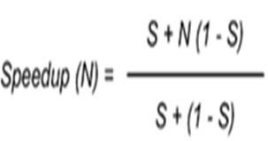

Equations of Gustafson’s law
The parallel portion of the workload (1-S) scales with the number of processor cores in the numerator of the equation, the serial portion (S) does not

Slide 115
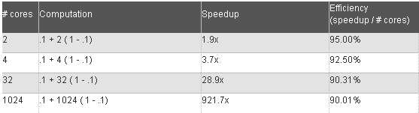
Gustafson's Trend applied to a hypothetical problem
Consider a computational load that is 10 percent serial, where the serial portion remains a fixed size and the parallel portion increases in size proportionally to the number of processor cores
These calculations show that the performance result continues to scale upward as more processor cores are applied to the computational load

Slide 116
Compare the two laws
Amdahl’s law:
Suppose two cities are 60 km apart, a car has spent one hour travelling the first 30 km. No matter how fast it drives the last 30 km, it is impossible to achieve 90 km/h before arriving the destination

Slide 117
Compare the two laws (Cont’d)
Gustafson’s law:
Suppose a car has already been travelling for some time at speed of less than 90km/h, and when given enough time and distance to travel, the car’s average speed can reach 90km/h as long as it drives faster than 90 km/h for some time. And also the average speed can reach 120km/h and even 150km/h as long as it drives fast enough in the following part

Slide 118
Conclusion
Amdahl’s presumption of fixed data size is obviously a restriction which does not map into reality for many problems
Both laws are in fact different perspective over the same truth – one sees data size as fixed and the other sees the relation as a function of data size

Slide 119
Moore’s Law by Mark Clements
Gordon Moore worked for Fairchild Semiconductors
He noticed a trend in IC manufacture
Every 2 years the number of components on an area of silicon doubled*
He published this work in 1965 – known as Moore’s Law
His predictions were for 10 years into the future
His work predicted personal computers and fast telecommunication networks

Slide 120
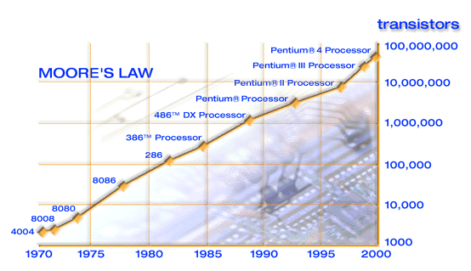
Graph of Moore’s Law

Slide 121
Why does the law exist?
Some of the factors that contribute to Moore’s Law:
Manufacturers wishing to keep up with the law
Competition between manufacturers
Successive technologies providing better design tools
Customer demand for better products
Man’s constant struggle to advance knowledge
There may be other factors too

Slide 122
The Next Step
Intel have announced that they have the technology to produce microprocessors containing more than 400 million transistors, running at 10 gigahertz and operating at less than one volt, in the next five to ten years.
This is in line with Moore’s law

Slide 123
The Current Limitations
Circuits cannot be reduced beyond atomic size
Quantum effects reduce the reliability as size decreases
Lithographic techniques become more complex as the size of components becomes smaller than the wavelength of light
Speed of electrical signals is finite
This suggests that Moore’s Law will finally end

Slide 124
Vectorization support on x86 architecture.
SIMD (Single Instruction Multiple Data) is a technique used to achieve data level parallelism.
A single SIMD instruction can perform the same operation on multiple data elements in parallel.
Since SIMD instructions operate on vectors, the operation is also known as vectorization

Slide 125
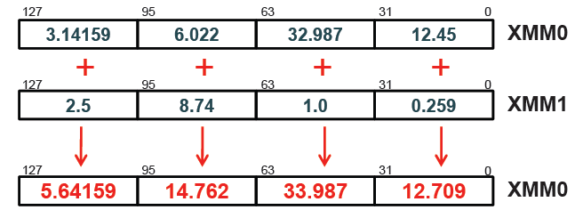
Vectorization support on x86
instruction for addition of two single precision floating point numbers.
ADDPS XMM0, XMM1
Each element of XMM register is a single precision floating point number
ADDPS instruction adds each element of XMM0 register to the corresponding element in the XMM1 register and stores the four results in the appropriate slots of XMM0 register

Slide 126
Vectorization support on x86
On Intel i7 processors, a floating-point addition (FADD) instruction on 32-bit registers has throughput of one instruction per cycle
The equivalent ADDPS instruction on 128-bit registers also has throughput of one instruction per cycle
However, ADDPS performs four additions, where as the FADD does only a single addition
Instead of a series of instructions for fetching each data element, a single SIMD instruction fetches all the data elements of the vector at once

Slide 127
Vectorization support on x86
MMX (1996, Pentium)
CPU-based MPEG decoding
Integers only, 64-bit divided into 2 x 32 to 8 x 8
Phased out with SSE4
SSE (1999, Pentium III)
CPU-based 3D graphics
4-way float operations, single precision
8 new 128 bit Register, 100+ instructions

Slide 128
Vectorization support on x86
SSE2 (2001, Pentium 4)
High-performance computing
Adds 2-way float ops, double-precision; same registers as 4-way single-precision
Integer SSE instructions make MMX obsolete
SSE3 (2004, Pentium 4E Prescott)
Scientific computing
New 2-way and 4-way vector instructions for complex arithmetic

Slide 129
Vectorization support on x86
SSE4 (2007, Core2 Duo Penryn)
Modern codecs, cryptography
New integer instructions
Better support for unaligned data
Advanced Vector Extensions (AVX) (2011, Sandy Bridge )
AVX instructions operate on 256-bit data
suitable for applications that include floating point intensive operations
AVX offers improved performance with multi-core processors.

Slide 130
Thank you

